Slide 1


Ahsanullah University of Science &Technology
Department of Computer Science and Engineering
Information System Design
&
Software Engineering Lab
CSE – 3224

Slide 2
Project Name: car rental system
Submitted By,
Jebin Tasnim ID:14.01.04.056
Redwanul Rahman ID:14.01.04.058
Muntasir Mamoor ID:14.01.04.072
Fatin Noor Anik ID:14.01.04.073

Slide 3
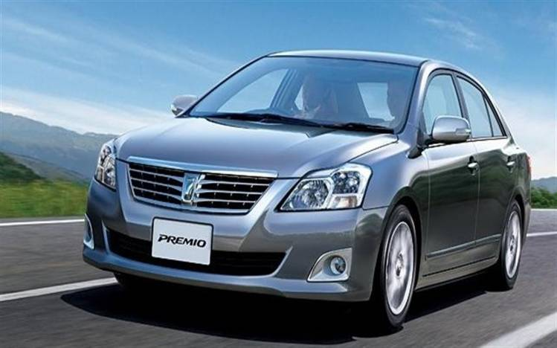
CAR RENTAL SYSTEM

Slide 4
Why CAR RENTAL SYSTEM?
most of the people don’t have their own car so face transportation problem when they want to travel with their family. In marriage ceremony program people face this transportation problem .
Besides tourists are also face with this problem in tourist spot.
CAR RENTAL SYSTEM apps reduce all this transportation problem and it helps minimize time and cost efficiently.

Slide 5
Project Goals
Providing better accessibility and up to date information for customer .
Managing important data and information of car and customer and place.
Making opportunities for the customer /tourist to pay cash on delivary.
Providing a friendly interface for the customer/tourist
Giving opportunity for the customer to do a negative or positive review.

Slide 6





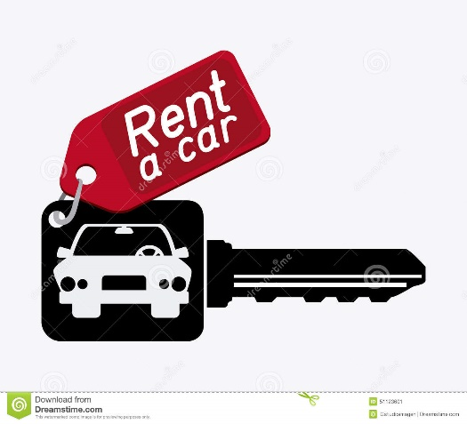
Features
CAR Info
Admin Privilege
CUSTOMER Info
Root/place
fare info
Rent info

Slide 7
Feasibilities
We have taken three feasibilities in account :
Technical Feasibility
Economical Feasibility
Operational Feasibility

Slide 8
Technical Feasibility
As we are using PHP as server side language, it will be :
Reliable
Available
Compatible with any kind of upgrade.
And using HTML & CSS to make the interface, gives us :
Better & attractive design

Slide 9
Economical Feasibility
Cost of programmer, debugger, tester
Cost of server, storage, internet connection
Cost of full system study
Salary of operators

Slide 10
Operational Feasibility
Reduce transportation problem for tourist.
low cost and quick service provide.
Provide 24 hour access for the users.

Slide 11
Scheduling Feasibility
Communication: 14 days
Project Initiation: 7 days
Requirement Gathering: 7 days
Planning : 20 days
Scheduling:5 days
Modeling: 14 days
Analysis: 12 days
Design: 7 days
Construction: 21 days
Test : 5 days
Deployment: 14 days
Feedback: 10 days

Slide 12
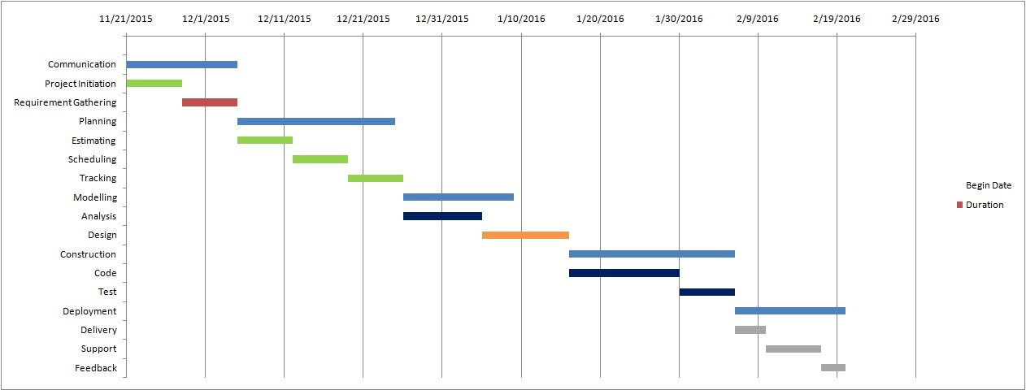
Gantt Chart

Slide 13
Costs
Tangible costs :
Cost of Programmer
Cost of gathering resources and equipments
Cost of system analysts time
lntangible costs :
Losing competitive edge.
Losing reputation
Customer dissatisfaction

Slide 14
Benefits
Tangible:
Well arranged resources in a single system
Saving of time due to completion of project before deadline
Intangible:
Popularity will increase if the project is delivered to the client properly.
Increasing user awareness of the availability of service.

Slide 15
Cost benefit analysis
Equation of present value is PVn = FV/(1/1+i)^n
Here,
PV= Present Value,
FV= Future Value,
i= interest,
n= time in years.

Slide 16
Project could be at the point of risk if:
Failure of completion the project by deadline.
The client is not satisfied with the design and performance.
Delaying of providing customer service.
Undetected bugs and crashes appears.
Any kind of storage failure may result in wiping out the data.

Slide 17


